Slide 1



Topic Title: Social Media and News Dissemination: Impact Analysis
Student ID and Name: 202132090 Muhammad Mujtaba Zaman
Instructor Name: Saeed Muhammad

Slide 2

Outline
Evolution
Benefits
Challenges
Societal Impact
Media Algorithms
Government Regulations
Future

Slide 3
Introduction
Many platforms are used like Arab News, Saudi Gazette, twitter, and snapchat for news
Saudi Arabia ranks among one of the highest social media usage societies

Slide 4
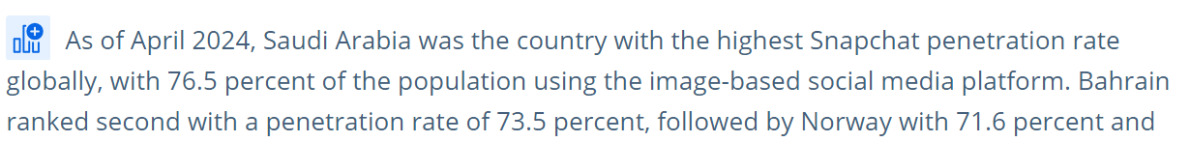
Evolution of news dissemination
We used to have traditional newspapers for news like Arab News, al Jazirah, Saudi Gazette
There also used to be magazines like Ahlan Wasahlan from Saudi Arabian airlines that has been cancelled
Nowadays newspapers have shifted to online form
Arab people also use more social media like twitter or snapchat to find news in KSA
[4]
S. J. Dixon, “Snapchat usage reach by country 2024,” Statista, Jun. 26, 2024. https://www.statista.com/statistics/326445/leading-snapchat-market/

Slide 5
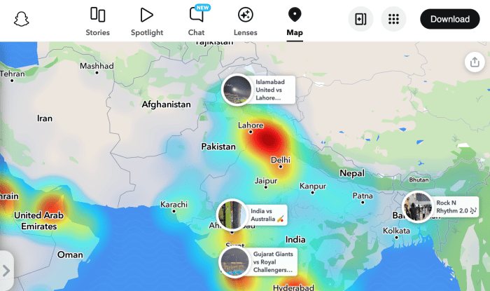
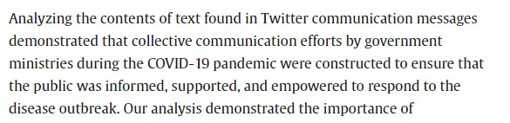
Benefits of social media for news dissimanation
You can get real time updates from social media sites like snapchat
There are multiple sources that are reporting on same event giving you multiple opinions on an event
You can also share your opinion and read other people's opinion on events
[5]
R. N. Aldekhyyel et al., “The Saudi Ministries Twitter communication strategies during the COVID-19 pandemic: A qualitative content analysis study,” Public Health in Practice, vol. 3, p. 100257, Apr. 2022, doi: https://doi.org/10.1016/j.puhip.2022.100257.

Slide 6
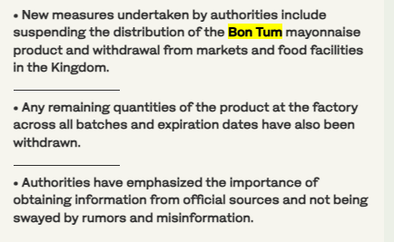

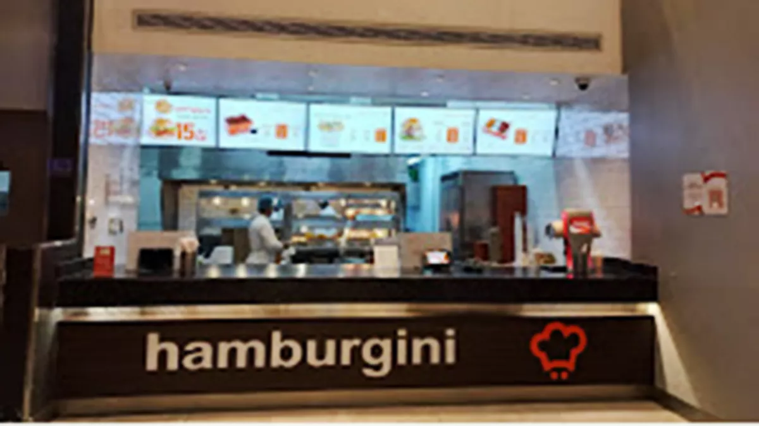
Challenges of social media news dissimanation
Challenges include misinformation on social media
Unknown details might lead to people making wrong assumptions
Hamburgini burger food poisoning was caused by the mayonnaise supplier caused people to not order online
[3]
Ghadi Joudah, “Botulism outbreak traced to mayonnaise at Riyadh restaurant,” Arab News, May 11, 2024. https://www.arabnews.com/node/2508531/saudi-arabia

Slide 7
Societal Impact of many news
Previously people watched one single main tv channel where they get their news
As we have more options to see news, we don’t watch same news
Leading to people not seeing same news events
This is further not helped by algorithms that give individuals different news that they are interested in
This hurts real life conversations people don’t have the same news stories to share (no conversation starters)
[2]
M. Pat and The Film Theorists, “Film Theory: How YouTube BROKE Your Brain!,” www.youtube.com, Dec. 10, 2023. https://www.youtube.com/watch?v=RXiLAn3vUKg (accessed Dec. 12, 2023).

Slide 8
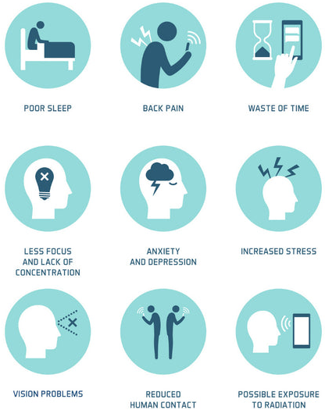
Media Algorithms
As many people use social media, algorithms affect us more with us not realizing it
People get addicted to social media
People only look at their own news personalities without looking at other people's perspective
This is accelerated by media algorithms showing you only what you want to see

Slide 9



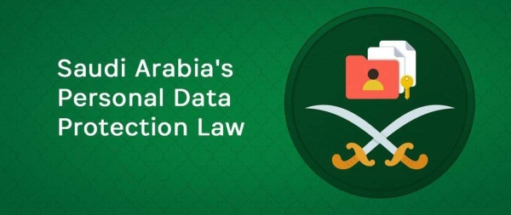
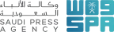
Government Regulations
PDPL laws for personal data implemented September 2023 for data privacy and protection
New rules are constantly being introduced
New regulation is still a slow process for uncharted territories like media algorithms that are difficult to make rules for (at what point they become harmful)
[1]
Ksenia Andreeva and A. Neskoromyuk, “Saudi Arabia Personal Data Protection Law: Transition Period Ends September 14,” Morganlewis.com, Sep. 12, 2024. https://www.morganlewis.com/pubs/2024/09/saudi-arabia-personal-data-protection-law-transition-period-ends-september-14

Slide 10
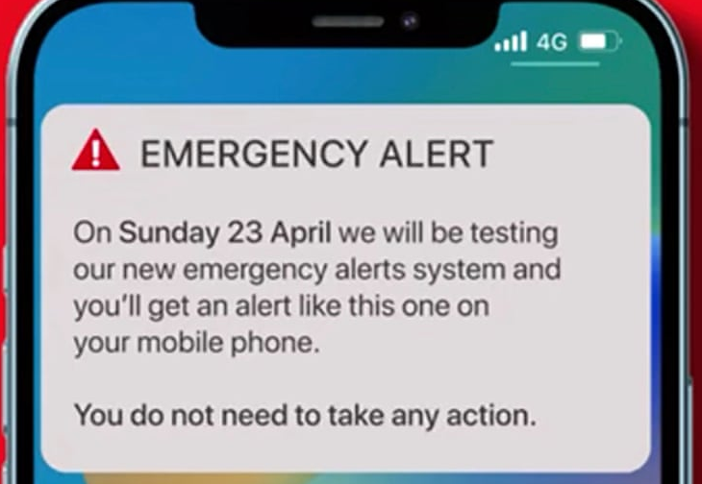

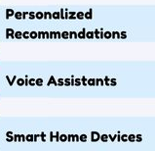
Future of news dissemination
AI algorithms will continue to grow
AI can help in publishing process and disseminate urgent news
KSA will need to become more flexible and adapt to future news transformations
KSA willl need to combat misinformation from social media
[6]
N. Alturki, “Challenges of the future discussed at Saudi Media Forum’s closing day,” Arab News, Feb. 21, 2024. https://www.arabnews.com/node/2467926/media (accessed Nov. 30, 2024).

Slide 11
Conclusion
KSA uses social media mainly for news dissemination
There are many challenges relating to social media usage
We need to take them into consideration

Slide 12
References
[1]
Ksenia Andreeva and A. Neskoromyuk, “Saudi Arabia Personal Data Protection Law: Transition Period Ends September 14,” Morganlewis.com, Sep. 12, 2024. https://www.morganlewis.com/pubs/2024/09/saudi-arabia-personal-data-protection-law-transition-period-ends-september-14
[2]
M. Pat and The Film Theorists, “Film Theory: How YouTube BROKE Your Brain!,” www.youtube.com, Dec. 10, 2023. https://www.youtube.com/watch?v=RXiLAn3vUKg (accessed Dec. 12, 2023).
[3]
Ghadi Joudah, “Botulism outbreak traced to mayonnaise at Riyadh restaurant,” Arab News, May 11, 2024. https://www.arabnews.com/node/2508531/saudi-arabia
[4]
S. J. Dixon, “Snapchat usage reach by country 2024,” Statista, Jun. 26, 2024. https://www.statista.com/statistics/326445/leading-snapchat-market/
[5]
R. N. Aldekhyyel et al., “The Saudi Ministries Twitter communication strategies during the COVID-19 pandemic: A qualitative content analysis study,” Public Health in Practice, vol. 3, p. 100257, Apr. 2022, doi: https://doi.org/10.1016/j.puhip.2022.100257.
[6]
N. Alturki, “Challenges of the future discussed at Saudi Media Forum’s closing day,” Arab News, Feb. 21, 2024. https://www.arabnews.com/node/2467926/media (accessed Nov. 30, 2024).
Any Questions
Thank you for Watching and Listening

